Slide 1
ADVANCED DATA STRUCTURES
By
K. Govindaraju
Associate Professor
Dept. of Computer Science and Engineering
Aditya Engineering College(A)
Surampalem

Slide 2
Basic Data Structures -Data Collections
Linear structures
  Array: Fixed-size
  Linked-list: Variable-size
  Stack: Add to top and remove from top
  Queue: Add to back and remove from front
  Non Linear structures
  Tree: A branching structure with no loops
Graph: A more general branching structure, with less stringent connection conditions than for a tree
K. Govindaraju, Associate Professor

Slide 3
Operations performed
Insertion -Adding a new element.
Traversal -Processing each element in the list
Searching -Finding location of an element
Deletion - Removing an element
Sorting -Arranging elements in some type of order
Merging -Combining two lists into a single list
K. Govindaraju, Associate Professor

Slide 4
Array Operations and time Complexity
2 | 7 | 22 | 6 | 5
Insert 3 at first location no. of shifts ?
Delete 2 no. of shifts ?
Time Complexity : O(n)
Linear search O(1) : best O(n) : worst
Binary Search O(log n) all cases and sorting
K. Govindaraju, Associate Professor

Slide 5
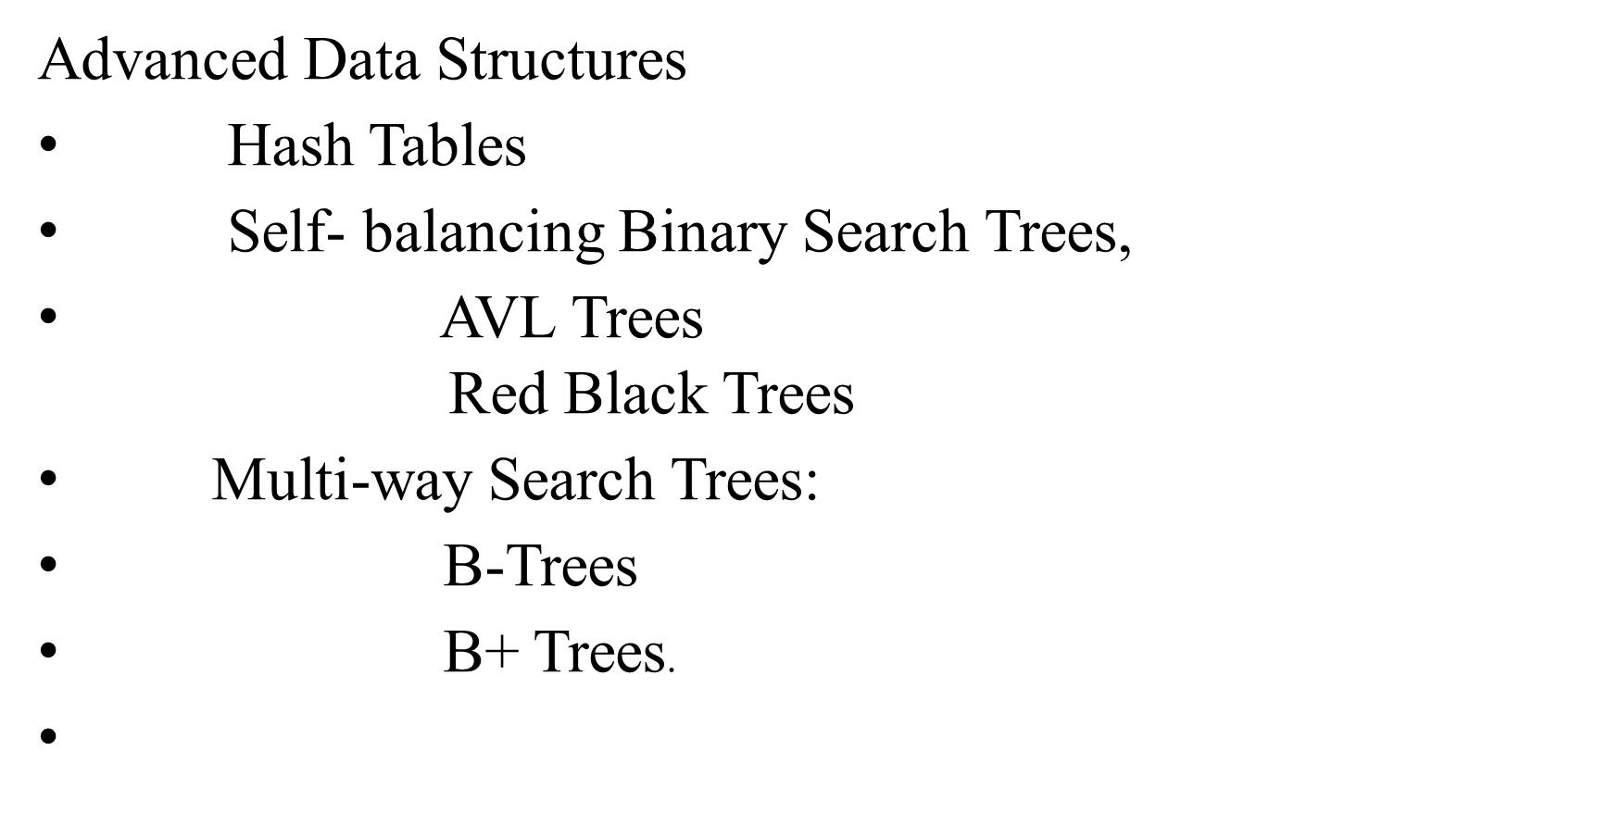
K. Govindaraju, Associate Professor

Slide 6
Comparison of Time complexities
 | Insert | Search | Delete
Unsorted list | O(1) | O(n) | O(n)
Unsorted array | O(n) | O(n) | O(n)
Sorted array | O(n) | O(log n) | O(n)
Trees | O(log n) | O(log n) | O(log n)
Array special case known keys ∈ {1, … , K} | O(1) | O(1) | O(1)
K. Govindaraju, Associate Professor

Slide 7
Why not just use an array with direct addressing (where each array cell corresponds to a key)?
  Direct-addressing guarantees O(1) worst-case time for Insert/Delete/Search.
K. Govindaraju, Associate Professor

Slide 8

Hashing is a process of finding an address where the data is to be stored as well as located using a key with the help of the algorithmic function
Hashing is a method of directly computing the address of the record with the help of a key by using a suitable mathematical function called the hash function
Hannah
f(x)
Dave
Adrien
Donald
Ed
Hash function
Keys
Hash Table Dictionary Data Structure
K. Govindaraju, Associate Professor

Slide 9
key
Home Address | Data (key)
0 | Kumar-36
1 | Surya-27
2 | Sundar-32
3
4 | Narayana-31
.
.
.
8
9
Hash Function(key)
Address
Hashing Process
The resulting address is used as the basis for storing and retrieving records and this address is called as home address of the record
For array to store a record in a hash table, hash function is applied to the key of the record being stored, returning an index within the range of the hash table
The item is then stored in the table of that index position
K. Govindaraju, Associate Professor

Slide 10

A function that maps a key into the range [0 to Max − 1], the result of which is used as an index (or address) to hash table for storing and retrieving record
The address generated by hashing function is called as home address
All home addresses address to particular area of memory and that area is called as prime area
  It is easy to compute
  It satisfies uniform hashing
K. Govindaraju, Associate Professor

Slide 11
Hash Function
Hash Function, h is simply a mathematical formula which when applied to the key, produces an integer which can be used as an index for the key in the hash table. The main aim of a hash function is that elements should be relatively randomly and uniformly distributed.
Hash function produces a unique set of integers within some suitable range. Such function produces no collisions. But practically speaking, there is no hash function that eliminates collision completely. A good hash function can only minimize the number of collisions by spreading the elements uniformly throughout the array.
K. Govindaraju, Associate Professor

Slide 12
Properties of Good Hash Function
Low Cost – executing time must be very small
Determinism – same hash value must be generated for a given input.
Uniformity – must map the keys as evenly as possible.
DIFFERENT HASH FUNCTIONS
Assuming numeric keys are being used, the hash functions mostly used are
Division method
Multiplication method
Mid-square method
Folding method
K. Govindaraju, Associate Professor

Slide 13
Hash Function-Division Method
Division method is the most simple method of hashing an integer x. The method divides x by M and then use the remainder thus obtained. In this case, the hash function can be given as
h(x) = x mod M
The division method is quite good for just about any value of M and since it requires only a single division operation, the method works very fast. However, extra care should be taken to select a suitable value for M.
K. Govindaraju, Associate Professor

Slide 14
Hash Function-Division Method
For example, M is an even number, then h(x) is even if x is even; and h(x) is odd if x is odd. If all possible keys are equi-probable, then this is not a problem. But if even keys are more likely than odd keys, then the division method will not spread hashed values uniformly.
Generally, it is best to choose M to be a prime number because making M a prime increases the likelihood that the keys are mapped with a uniformity in the output range of values.
K. Govindaraju, Associate Professor

Slide 15
Hash Function-Division Method
A potential drawback of the division method is that using this method, consecutive keys map to consecutive hash values. While on one hand this is good as it ensures that consecutive keys do not collide, but on the other hand it also means that consecutive array locations will be occupied. This may lead to degradation in performance.
Example: Calculate hash values of keys 1234 and 5462.
Setting m = 97, hash values can be calculated as
h(1234) = 1234 % 97 = 70
h(5642) = 5642 % 97 = 16
K. Govindaraju, Associate Professor

Slide 16
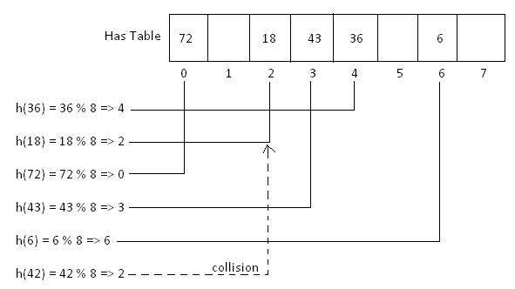
Hash Function-Division Method
Consider a Hash table with 8 slots. i.e. array size 8.
Hash Function (HF ) Hashcode = key % table size
The key values given are 36, 18, 72, 43, 6, 42
←------------------Buckets-------------------→
K. Govindaraju, Associate Professor
K. Govindaraju, Associate Professor

Slide 17
Hash Function-Multiplication Method
The steps involved in the multiplication method can be given as below:
Step 1: Choose a constant A such that 0 < A < 1.
Step 2: Multiply the key k by A
Step 3: Extract the fractional part of kA
Step 4: Multiply the result of Step 3 by m and take the floor.
Hence, the hash function can be given as,
h (x) = └ m ( k A mod 1) ┘
where, kA mod 1 gives the fractional part of kA and m is the total number of indices in the hash table
The greatest advantage of the multiplication method is that it works practically with any value of A. Although the algorithm works better with some values than the others but the optimal choice depends on the characteristics of the data being hashed. Knuth has suggested that the best choice of A is
» (sqrt5 - 1) /2 = 0.6180339887
K. Govindaraju, Associate Professor

Slide 18
Hash Function-Multiplication Method
Example: Given a hash table of size 1000, map the key 12345 to an appropriate location in the hash table
We will use A = 0.618033, m = 1000 and k = 12345
h(12345) = └ 1000 ( 12345 X 0.618033 mod 1 ) ┘
= └ 1000 ( 7629.617385 mod 1 ) ┘
= └ 1000 ( 0.617385) ┘
= 617.385
= 617
K. Govindaraju, Associate Professor

Slide 19
Hash Function-Mid Square Method
Mid square method is a good hash function which works in two steps.
Step 1: Square the value of the key. That is, find k²
Step 2: Extract the middle r bits of the result obtained in Step 1.
The algorithm works well because most or all bits of the key value contribute to the result. This is because all the digits in the original key value contribute to produce the middle two digits of the squared value. Therefore, the result is not dominated by the distribution of the bottom digit or the top digit of the original key value.
In the mid square method, the same r bits must be chosen from all the keys. Therefore, the hash function can be given as,
h (k) = s
where, s is obtained by selecting r bits from k²
K. Govindaraju, Associate Professor

Slide 20
Hash Function-Mid Square Method
Example: Calculate the hash value for keys 1234 and 5642 using the mid square method. The hash table has 100 memory locations.
Note the hash table has 100 memory locations whose indices vary from 0-99. this means, only two digits are needed to map the key to a location in the hash table, so r = 2.
When k = 1234, k2 = 1522756, h (k) = 27
When k = 5642, k2 = 31832164, h (k) = 21
Observe that 3rd and 4th digits starting from the right are chosen.
K. Govindaraju, Associate Professor

Slide 21
Hash Function-Folding Method
The identifier x is partitioned into several parts, all but the last being of the same length.
All partitions are added together to obtain the hash address for x.
  Shift folding
    Different partitions are added together to get h(x).
  Folding at the boundaries
    Identifier is folded at the partition boundaries, and digits falling into the same position are added together to obtain h(x). This is similar to reversing every other partition and then adding.
K. Govindaraju, Associate Professor

Slide 22
Hash Function-Folding Method
The shift folding method works in two steps.
Step 1: Divide the key value into a number of parts. That is divide k into parts, k1, k2, …, kn, where each part has the same number of digits except the last part which may have lesser digits than the other parts.
Step 2: Add the individual parts. That is obtain the sum of k1 + k2 + .. + kn. Hash value is produced by ignoring the last carry, if any.
Note that the number of digits in each part of the key will vary depending upon the size of the hash table. For example, if the hash table has a size of 1000. Then it means there are 1000 locations in the hash table. To address these 1000 locations, we will need at least three digits, therefore, each part of the key must have three digits except the last part which may have lesser digits.
K. Govindaraju, Associate Professor

Slide 23
Hash Function-Folding Method
Example: Given a hash table of 100 locations, calculate the hash value using shift folding method for keys- 5678, 321 and 34567.
Here, since there are 100 memory locations to address, we will break the key into parts where each part (except the last) will contain two digits.
Therefore,
Key | 5678 | 321 | 34567
Parts | 56 and 78 | 32 and 1 | 34, 56 and 7
Sum | 134 | 33 | 97
Hash Value | 34 (ignore the last carry) | 33 | 97
K. Govindaraju, Associate Professor

Slide 24
K. Govindaraju, Associate Professor

Slide 25

If a hash function maps two different keys to same location, then it is called as collision. Obviously, two records can not be stored in the same location.
Therefore, a method used to solve the problem of collision also called collision resolution technique is applied.
The two most popular method of resolving collision are:
1) Collision resolution by open addressing (Closed Hashing)
2) Collision resolution by chaining -Closed Addressing(Open Hashing)
K. Govindaraju, Associate Professor

Slide 26
Collision Resolution by Open Addressing
Once a collision takes place, open addressing computes new positions using a probe sequence and the next record is stored in that position.
In this technique of collision resolution, all the values are stored in the hash table. The hash table will contain two types of values- either sentinel value (for example, -1) or a data value.
The presence of sentinel value indicates that the location contains no data value at present but can be used to hold a value.
The process of examining memory locations in the hash table is called probing.
Open addressing technique can be implemented using
1. linear probing
2. quadratic probing and
3. double hashing.
K. Govindaraju, Associate Professor

Slide 27

Closed hashing indicates that the hashing is limited(closed) to this hash table only and no buckets could be added or linked.
The simplest approach to resolve a collision is linear probing. In this technique, if a value is already stored at location generated by h(k), then the following hash function is used to resolve the collision.
h(k, i) = [h’(k) + i] mod m
where, m is the size of the hash table, h’(k) = k mod m and i is the probe number and varies from 0 to m-1.
K. Govindaraju, Associate Professor

Slide 28
Example: Consider a hash table with size = 10. Using linear probing insert the keys 72, 27, 36, 24, 63, 81 and 92 into the table.
Let h’(k) = k mod m, m = 10
Initially the hash table can be given as,
0 1 2 3 4 5 6 7 8 9
-1 | -1 | -1 | -1 | -1 | -1 | -1 | -1 | -1 | -1
Step1: Key = 72
h(72, 0) = (72 mod 10 + 0) mod 10
= (2) mod 10
= 2
Since, T[2] is vacant, insert key 72 at this location
0 1 2 3 4 5 6 7 8 9
-1 | -1 | 72 | -1 | -1 | -1 | -1 | -1 | -1 | -1
K. Govindaraju, Associate Professor

Slide 29
Step2: Key = 27
h(27, 0) = (27 mod 10 + 0) mod 10
= (7) mod 10
= 7
Since, T[7] is vacant, insert key 27 at this location
Step3: Key = 36
h(36, 0) = (36 mod 10 + 0) mod 10
= (6) mod 10
= 6
Since, T[6] is vacant, insert key 36 at this location
0 1 2 3 4 5 6 7 8 9
-1 | -1 | 72 | -1 | -1 | -1 | 36 | 27 | -1 | -1
K. Govindaraju, Associate Professor

Slide 30
Step4: Key = 24
h(24, 0) = (24 mod 10 + 0) mod 10
= (4) mod 10
= 4
Since, T[4] is vacant, insert key 24 at this location
0 1 2 3 4 5 6 7 8 9
-1 | -1 | 72 | -1 | 24 | -1 | 36 | 27 | -1 | -1
Step5: Key = 63
h(63, 0) = (63 mod 10 + 0) mod 10
= (3) mod 10
= 3
Since, T[3] is vacant, insert key 63 at this location
0 1 2 3 4 5 6 7 8 9
-1 | -1 | 72 | 63 | 24 | -1 | 36 | 27 | -1 | -1
K. Govindaraju, Associate Professor

Slide 31
Step6: Key = 81
h(81, 0) = (81 mod 10 + 0) mod 10
= (1) mod 10
= 1
Since, T[1] is vacant, insert key 81 at this location
0 1 2 3 4 5 6 7 8 9
-1 | 81 | 72 | 63 | 24 | -1 | 36 | 27 | -1 | -1
Step7: Key = 92
h(92, 0) = (92 mod 10 + 0) mod 10
= (2) mod 10
= 2
Now, T[2] is occupied, so we cannot store the key 92 in T[2]. Therefore, try again for next location. Thus probe, i = 1, this time.
Key = 92
h(92, 1) = (92 mod 10 + 1) mod 10
= (2 + 1) mod 10
= 3
K. Govindaraju, Associate Professor

Slide 32
Now, T[3] is occupied, so we cannot store the key 92 in T[3]. Therefore, try again for next location. Thus probe, i = 2, this time.
Key = 92
h(92, 2) = (92 mod 10 + 2) mod 10
= (2 + 2) mod 10
= 4
Now, T[4] is occupied, so we cannot store the key 92 in T[4]. Therefore, try again for next location. Thus probe, i = 3, this time.
Key = 92
h(92, 3) = (92 mod 10 + 3) mod 10
= (2 + 3) mod 10
= 5
Since, T[5] is vacant, insert key 92 at this location
0 1 2 3 4 5 6 7 8 9
-1 | -1 | 72 | 63 | 24 | 92 | 36 | 27 | -1 | -1
K. Govindaraju, Associate Professor

Slide 33
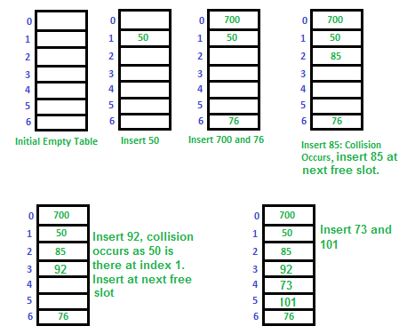
K. Govindaraju, Associate Professor

Slide 34
Searching a Value
When searching a value in the hash table, the array index is re-computed and the key of the element stored at that location is checked with the value that has to be searched.
If a match is found, then the search operation is successful. The search time in this case is given as O(1). Otherwise, if the key does not match, then the search function begins a sequential search of the array that continues until:
  the value is found
  the search function encounters a vacant location in the array, indicating that the value is not present
K. Govindaraju, Associate Professor

Slide 35
Searching a Value
The search function terminates because the table is full and the value is not present
In worst case, the search operation may have to make (n-1) comparison, and the running time of the search algorithm may take time given as O(n). The worst case will be encountered when the table is full and after scanning all n-1 elements, the value is either present at the last location or not present in the table.
Thus, we see that with increase in the number of collisions, the distance from the array index computed by the hash function and the actual location of the element increases, thereby increasing the search time.
K. Govindaraju, Associate Professor

Slide 36
Pros and Cons
Linear probing finds an empty location by doing a linear search in the array beginning from position h(k). Although, the algorithm provides good memory caching, through good locality of reference, but the drawback of this algorithm is that it results in clustering, and thus a higher risk that where there has been one collision there will be more. The performance of linear probing is sensitive to the distribution of input values.
In linear probing as the hash table fills, clusters of consecutive cells are formed and the time required for a search increases with the size of the cluster. In addition to this, when a new value has to be inserted in to the table at a position which is already occupied, that value is inserted at the end of the cluster, which all the more increases the length of the cluster.
K. Govindaraju, Associate Professor

Slide 37
Pros and Cons
Generally, an insertion is made between two clusters that are separated by one vacant location. But with linear probing there are more chances that subsequent insertions will also end up in one of the clusters, thereby potentially increasing the cluster length by an amount much greater than one. More the number of collisions, higher the probes that are required to find a free location and lesser is the performance. This phenomenon is called primary clustering. To avoid primary clustering, other techniques like quadratic probing and double hashing are used.
K. Govindaraju, Associate Professor

Slide 38
  Thank You
K. Govindaraju, Associate Professor

Slide 39

In this technique, if a value is already stored at location generated by h(k), then the following hash function is used to resolve the collision.
h(k, i) = [h’(k) + i²] mod m
where, m is the size of the hash table, h’(k) = k mod m and i is the probe number that varies from 0 to m-1.
Quadratic probing eliminates the primary clustering phenomenon of linear probing because instead of doing a linear search, it does a quadratic search. For a given key k, first the location generated by h’(k) mod m is probed.
If the location is free, the value is stored in it else, subsequent locations probed are offset by factors that depend in a quadratic manner on the probe number i. Quadratic probing performs better than linear probing.
K. Govindaraju, Associate Professor

Slide 40
Example: Consider a hash table with size = 10. Using quadratic probing insert the keys 72, 27, 36, 24, 63, 81 and 101 into the table.
Let h’(k) = k mod m, m = 10 (Try to insert 92 after all are inserted)
Initially the hash table can be given as,
-1 | -1 | -1 | -1 | -1 | -1 | -1 | -1 | -1 | -1
We have,
h(k, i) = [h’(k) + i^2] mod m
Step1: Key = 72
h(72) = [ 72 mod 10 + 0 X 0] mod 10
= [72 mod 10] mod 10
= 2 mod 10
= 2
Since, T[2] is vacant, insert the key 72 in T[2]. The hash table now becomes,
0 1 2 3 4 5 6 7 8 9
-1 | -1 | 72 | -1 | -1 | -1 | -1 | -1 | -1 | -1
K. Govindaraju, Associate Professor

Slide 41
Step2: Key = 27
h(27) = [ 27 mod 10 + 0 X 0] mod 10
= [27 mod 10] mod 10
= 7 mod 10
= 7
Since, T[7] is vacant, insert the key 27 in T[7]. The hash table now becomes,
0 1 2 3 4 5 6 7 8 9
-1 | -1 | 72 | -1 | -1 | -1 | -1 | 27 | -1 | -1
Step3: Key = 36
h(36) = [ 36 mod 10 + 0 X 0] mod 10
= [36 mod 10] mod 10
= 6 mod 10
= 6
Since, T[6] is vacant, insert the key 36 in T[6]. The hash table now becomes,
0 1 2 3 4 5 6 7 8 9
-1 | -1 | 72 | -1 | -1 | -1 | 36 | 27 | -1 | -1
K. Govindaraju, Associate Professor

Slide 42
Step4: Key = 24
h(24) = [ 24 mod 10 + 0 X 0] mod 10
= [24 mod 10] mod 10
= 4 mod 10
= 4
Since, T[4] is vacant, insert the key 24 in T[4]. The hash table now becomes,
0 1 2 3 4 5 6 7 8 9
-1 | -1 | 72 | -1 | 24 | -1 | 36 | 27 | -1 | -1
Step5: Key = 63
h(63) = [ 63 mod 10 + 0X 0] mod 10
= [63 mod 10] mod 10
= 3 mod 10
= 3
Since, T[3] is vacant, insert the key 63 in T[3]. The hash table now becomes,
0 1 2 3 4 5 6 7 8 9
-1 | -1 | 72 | 63 | 24 | -1 | 36 | 27 | -1 | -1
K. Govindaraju, Associate Professor

Slide 43
Step6: Key = 81
h(81) = [ 81 mod 10 + 0 X 0] mod 10
= [81 mod 10] mod 10
= 81 mod 10
= 1
Since, T[1] is vacant, insert the key 81 in T[1]. The hash table now becomes,
0 1 2 3 4 5 6 7 8 9
-1 | 81 | 72 | 63 | 24 | -1 | 36 | 27 | -1 | -1
K. Govindaraju, Associate Professor

Slide 44
Step7: Key = 101
h(101) = [101 mod 10 + 0 X 0] mod 10
= [101 mod 10 + 0] mod 10
= 1 mod 10
= 1
Since, T[1] is already occupied, the key 101 can not be stored in T[1]. Therefore, try again for next location. Thus probe, i = 1, this time.
Key = 101
h(101) = [ 101 mod 10 + 1X1] mod 10
= [101 mod 10 + 1 ] mod 10
= [1 + 1] mod 10
= 2 mod 10
= 2
Since, T[2] is already occupied, the key 101 can not be stored in T[2]. Therefore, try again for next location.
0 1 2 3 4 5 6 7 8 9
-1 | 81 | 72 | 63 | 24 | -1 | 36 | 27 | -1 | -1
K. Govindaraju, Associate Professor

Slide 45
Thus probe, i = 2, this time.
Key = 101
h(101) = [ 101 mod 10 + 2X2] mod 10
= [101 mod 10 + 4 ] mod 10
= [1 + 4] mod 10
= 5mod 10
= 5
Since, T[5] is vacant, insert the key 101 in T[5]. The hash table now becomes,
0 1 2 3 4 5 6 7 8 9
-1 | 81 | 72 | 63 | 24 | 101 | 36 | 27 | -1 | -1
K. Govindaraju, Associate Professor

Slide 46
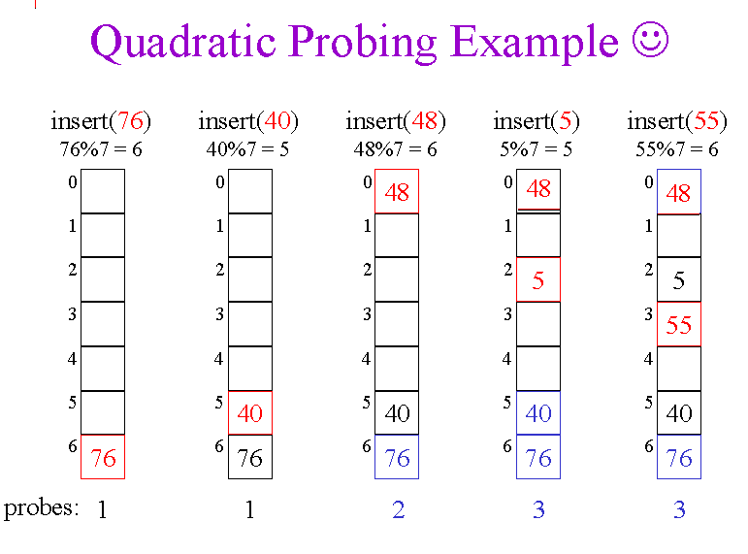
K. Govindaraju, Associate Professor

Slide 47
Searching a Value
While searching for a value using quadratic probing technique, the array index is re-computed and the key of the element stored at that location is checked with the value that has to be searched. If the desired key value matches the key value at that location, then the element is present in the hash table and the search is said to be successful. In this case the search time is given as O(1). However, if the value does not match then, the search function begins a search of the array that continues until:
  the value is found
  the search function encounters a vacant location in the array, indicating that the value is not present
  the search function terminates because the table is full and the value is not present
K. Govindaraju, Associate Professor

Slide 48
Cons and Pros
Quadratic probing caters to the primary clustering problem that exists in linear probing technique. Quadratic probing provides good memory caching because it preserves some locality of reference. But linear probing does this task better and gives better cache performance.
One of the major drawbacks with quadratic probing is that a sequence of successive probes may only explore a fraction of the table, and this fraction may be quite small. If this happens then we will not be able to find an empty location in the table despite the fact that the table is by no means full.
Although quadratic probing is free from primary clustering, but it is still liable to what is known as secondary clustering. This means that if there is a collision between two keys then the same probe sequence will be followed for both. (Try to insert key 92 and you will see how this happens). With quadratic probing, potential for multiple collisions increases as the table becomes full. This situation is usually encountered when the hash table is more than full.
Quadratic probing is widely applied in the Berkeley Fast File System to allocate free blocks.
K. Govindaraju, Associate Professor

Slide 49
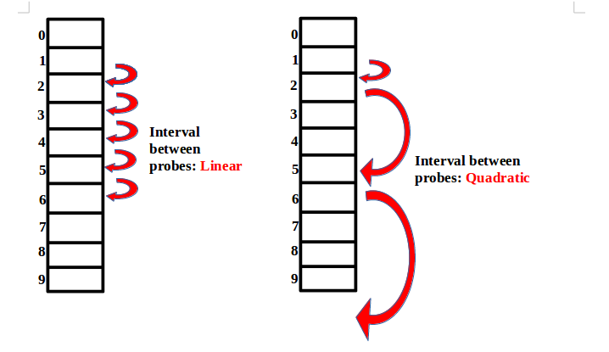
K. Govindaraju, Associate Professor

Slide 50

To start with double hashing uses one hash value and then repeatedly steps forward an interval until an empty location is reached. The interval is decided using a second, independent hash function, hence the name double hashing. Therefore, in double hashing we use two hash functions rather a single function. The hash function in case of double hashing can be given as,
h(k, i) = [h1(k) + i*h2(k)] mod m
where, m is the size of the hash table, h1(k) and h2(k) are two hash functions given as, h1(k) = k mod m, h2(k) = k mod m’, i is the probe number that varies from 0 to m-1 and m’ is chosen to be less than m. we can choose m’ = m-1 or m-2.
K. Govindaraju, Associate Professor

Slide 51
When we have to insert a key k in the hash table, we first probe the location given by applying h1(k) mod m because during the first probe, i = 0.
If the location is vacant the key is inserted into it, else subsequent probes generate locations that are at an offset of h2(k) mod m from the previous location.
Since the offset may vary with every probe depending on the value generated by second hash function, the performance of double hashing is very close to the performance of the ideal scheme of uniform hashing.
K. Govindaraju, Associate Professor

Slide 52
Double hashing minimizes repeated collisions and the effects of clustering. That is, double hashing is free from problems associated with primary clustering as well secondary clustering.
Example: Consider a hash table with size = 11. Using double hashing insert the keys 72, 27, 36, 24, 63, 81, 92 and 101 into the table. Take h1 = k mod 11 and h2 = k mod 7. Let m = 11 Initially the hash table can be given as,
0 | 1 | 2 | 3 | 4 | 5 | 6 | 7 | 8 | 9 | 10
-1 | -1 | -1 | -1 | -1 | -1 | -1 | -1 | -1 | -1 | -1
We have,
h(k, i) = [h1(k) + ih2(k)] mod m
Step1: Key = 72
h(72, 0) = [ 72 mod 11 + (0 X 72 mod 7] mod 11
= [ 6+ ( 0 X 2) ] mod 11
= 6 mod 11 = 6
Since, T[6] is vacant, insert the key 72 in T[6]. The hash table now becomes,
0 | 1 | 2 | 3 | 4 | 5 | 6 | 7 | 8 | 9 | 10
-1 | -1 | -1 | -1 | -1 | -1 | 72 | -1 | -1 | -1 | -1
K. Govindaraju, Associate Professor

Slide 53
Step2: Key = 27
h(27, 0) = [ 27 mod 11+ (0 X 27 mod 7)] mod 11
= [5 + ( 0 ) ] mod 11
= 5 mod 11
= 5
Since, T[5] is vacant, insert the key 27 in T[5]. The hash table now becomes,
0 | 1 | 2 | 3 | 4 | 5 | 6 | 7 | 8 | 9 | 10
-1 | -1 | -1 | -1 | -1 | 27 | 72 | -1 | -1 | -1 | -1
Step3: Key = 36
h(36, 0) = [36 mod 11 + (0 X 36 mod 7)] mod 11
= [3 + ( 0 ) ] mod 11
= 3 mod 11
= 3
Since, T[3] is vacant, insert the key 36 in T[3]. The hash table now becomes,
0 | 1 | 2 | 3 | 4 | 5 | 6 | 7 | 8 | 9 | 10
-1 | -1 | -1 | 36 | -1 | 27 | 72 | -1 | -1 | -1 | -1
K. Govindaraju, Associate Professor

Slide 54
Step4 Key = 24
h(24, 0) = [ 24 mod 11+ (0 X 27 mod 7)] mod 11
= [2 + ( 0 ) ] mod 11
= 2 mod 11
= 2
Since, T[2] is vacant, insert the key 27 in T[2]. The hash table now becomes,
0 | 1 | 2 | 3 | 4 | 5 | 6 | 7 | 8 | 9 | 10
-1 | -1 | 24 | 36 | -1 | 27 | 72 | -1 | -1 | -1 | -1
Step5: Key = 63
h(63, 0) = [63 mod 11 + (0 X 63 mod 7)] mod 11
= [8 + ( 0 ) ] mod 11
= 8 mod 11
= 8
Since, T[8} is vacant, insert the key 63 in T[8]. The hash table now becomes,
0 | 1 | 2 | 3 | 4 | 5 | 6 | 7 | 8 | 9 | 10
-1 | -1 | -1 | 36 | -1 | 27 | 72 | -1 | 63 | -1 | -1
K. Govindaraju, Associate Professor

Slide 55
Step 6: Key = 81
h(92, 0) = [81 mod 11 + (0 X 81 mod 7)] mod 11
= [4 + ( 0 ) ] mod 11
= 4 mod 11
= 4
Since, T[4] is vacant, insert the key 81 in T[4]. The hash table now becomes,
Step 7: Key = 92
h(92, 0) = [92 mod 11 + (0 X 92 mod 7)] mod 11
= [4 + ( 0 X 1) ] mod 11
= (4 + 0) mod 11
= 4 mod 11
= 4
Now, T[4] is occupied, so we cannot store the key 92 in T[4]. Therefore, try again for next location
0 | 1 | 2 | 3 | 4 | 5 | 6 | 7 | 8 | 9 | 10
-1 | -1 | -1 | 36 | 81 | 27 | 72 | -1 | 63 | -1 | -1
K. Govindaraju, Associate Professor

Slide 56
Thus probe, i = 1, this time.
Key = 92
h(92, 1) = [92 mod 11 + (1 X 92 mod 7)] mod 11
= [4 + ( 1 X 1) ] mod 11
= (4 + 1) mod 11
= 5 mod 11
= 5
Now, T[5] is occupied, so we cannot store the key 92 in T[5]. Therefore, try again for next location. Thus probe, i = 2, this time.
Key = 92
h(92, 2) = [92 mod 11 + (2 X 92 mod 7)] mod 11
= [4 + ( 2 X 1) ] mod 11
= (4 + 2) mod 11
= 6 mod 11
= 6
Now, T[6] is occupied, so we cannot store the key 92 in T[6]. Therefore, try again for next location.
0 | 1 | 2 | 3 | 4 | 5 | 6 | 7 | 8 | 9 | 10
-1 | -1 | -1 | 36 | 81 | 27 | 72 | -1 | 63 | -1 | -1
K. Govindaraju, Associate Professor

Slide 57
Thus probe, i = 3, this time.
Key = 92
h(92, 3) = [92 mod 11 + (3 X 92 mod 7)] mod 11
= [4 + ( 3 X 1) ] mod 11
= (4 + 3) mod 11
= 7 mod 11
= 7
Since, T[7] is vacant, insert the key 92 in T[7]. The hash table now becomes,
0 | 1 | 2 | 3 | 4 | 5 | 6 | 7 | 8 | 9 | 10
-1 | -1 | -1 | 36 | 81 | 27 | 72 | 92 | 63 | -1 | -1
K. Govindaraju, Associate Professor

Slide 58

When the hash table becomes nearly full, the number of collisions increases, thereby degrading the performance of insertion and search operations.
A better option is to create a new hash table with size double of the original hash table.
All the entries in the original hash table will then have to be moved to the new hash table by taking each entry, computing its new hash value, and then inserting it in the new hash table.
Though rehashing seems to be a simple process, it is quite expensive and must therefore not be done frequently.
K. Govindaraju, Associate Professor

Slide 59
Consider the hash table of size 5 given below. The hash function used is h(x) = x % 5. Insert 26,31,43,17.
Rehash the entries into to a new hash table as the hash table is almost full.
Note that the new hash table is of 10 locations, double the size of the original table.
Now, rehash the key values from the old hash table into the new one using hash function h(x) = x % 10.
0 1 2 3 4
-1 | 26 | 31 | 43 | 17
0 1 2 3 4 5 6 7 8 9
-1 | 31 | -1 | 43 | -1 | -1 | 26 | 17 | -1 | -1
K. Govindaraju, Associate Professor

Slide 60
K. Govindaraju, Associate Professor

Slide 61

  Closed addressing is one of the collision resolution technique, in which we cannot store keys at everywhere in the hash table, other than hash value.
  If keys are generating same hash code, then collision occurs. In that case we store all keys in linked list, in the same level
  There is only one technique, that is separate chaining, that resolve the collisions.
K. Govindaraju, Associate Professor

Slide 62

In chaining, each location in the hash table stores a pointer to a linked list that contains the all key values that were hashed to the same location.
That is, location l in the hash table points to the head of the linked list of all the key values that hashed to l.
However, if no key value hashes to l, then location l in the hash table contains NULL.
Figure shows how the key values are mapped to a location l in the hash table and stored in a linked list that corresponds to l.
K. Govindaraju, Associate Professor

Slide 63
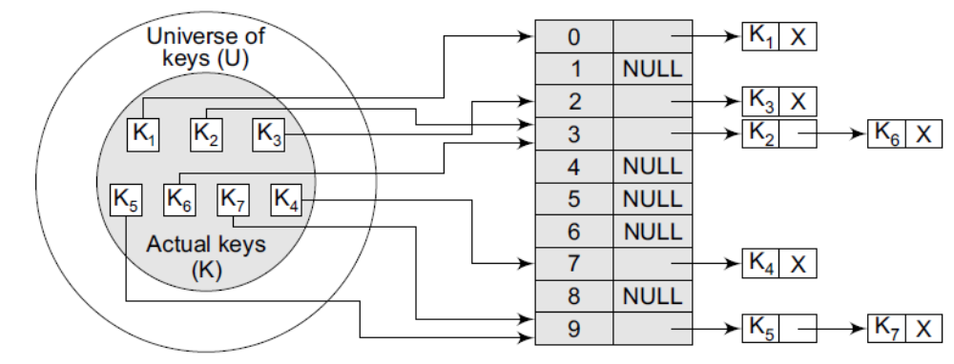
Keys being hashed to a chained hash table
K. Govindaraju, Associate Professor

Slide 64
Example: Insert the keys 7, 24, 18, and 52 in a chained hash table of 9 memory locations. Use h(k) = k mod m
0 | NULL
1 | NULL
2 | NULL
3 | NULL
4 | NULL
5 | NULL
6 | NULL
7 | NULL
8 | NULL
K. Govindaraju, Associate Professor

Slide 65
Example: Insert the keys 7, 24, 18, and 52 in a chained hash table of 9 memory locations. Use h(k) = k mod m
In this case, m=9. Initially, the hash table can be given as
Step 1: Key = 7
0 | NULL
1 | NULL
2 | NULL
3 | NULL
4 | NULL
5 | NULL
6 | NULL
7
8 | NULL
Step 2: Key = 24
h(k) = 24 mod 9
= 6
0 | NULL
1 | NULL
2 | NULL
3 | NULL
4 | NULL
5 | NULL
6
7
8 | NULL
7 X
24 X
7 X
K. Govindaraju, Associate Professor

Slide 66
Step 3: Key = 18
h(k) = 18 mod 9 = 0
0
1 | NULL
2 | NULL
3 | NULL
4 | NULL
5 | NULL
6
7
8 | NULL
18 X
24 X
7 X
0
1 | NULL
2 | NULL
3 | NULL
4 | NULL
5 | NULL
6
7
8 | NULL
18 X
Step 4: Key = 52
h(k) = 52 mod 9
= 7
Insert 52 in the beginning of the linked list of location 7
24 X
7
52 X
K. Govindaraju, Associate Professor

Slide 67
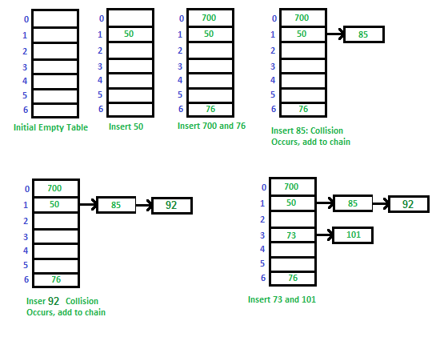
K. Govindaraju, Associate Professor

Slide 68
Advantages:
Simple to implement.
Hash table never fills up, we can always add more elements to the chain.
Less sensitive to the hash function
It is mostly used when it is unknown how many and how frequently keys may be inserted or deleted.
Disadvantages:
Cache performance of chaining is not good as keys are stored using a linked list. Open addressing provides better cache performance as everything is stored in the same table.
Wastage of Space (Some Parts of hash table are never used
If the chain becomes long, then search time can become O(n) in the worst case.
Uses extra space for links.
K. Govindaraju, Associate Professor

Slide 69
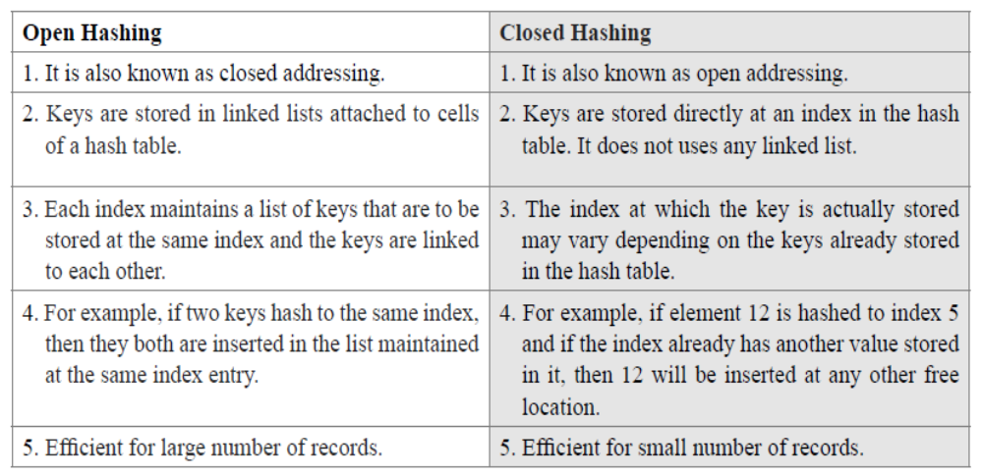
K. Govindaraju, Associate Professor

